Slide 1

MEDICAL COST ANALYSIS
AMISH ILYAS

Slide 2


AGENDA
Problem Statement
Dataset Overview and Tools
Dashboards
Hypothesis Testing
Insights
Contact Info

Slide 3

PROBLEM STATEMENT
Problem Statement: What are the key factors that significantly impact medical costs for individuals?
Objective: Perform an exploratory data analysis to identify which factors (e.g., age, BMI, smoking status) are most strongly correlated with high medical costs.

Slide 4




DATASET OVERVIEW AND TOOLS
About Dataset : Dataset Contains Following Attributes
age: age of primary beneficiary
sex: insurance contractor gender, female, male
bmi: Body mass index, providing an understanding of body, weights that are relatively high or low relative to height, objective index of body weight (kg / m ^ 2) using the ratio of height to weight, ideally 18.5 to 24.9
children: Number of children covered by health insurance / Number of dependents
smoker: Smoking
region: the beneficiary's residential area in the US, northeast, southeast, southwest, northwest.
charges: Individual medical costs billed by health insurance
Tools: These tools have used to Perform the Data Analysis and Project creation Excel , SQL , Python .

Slide 5
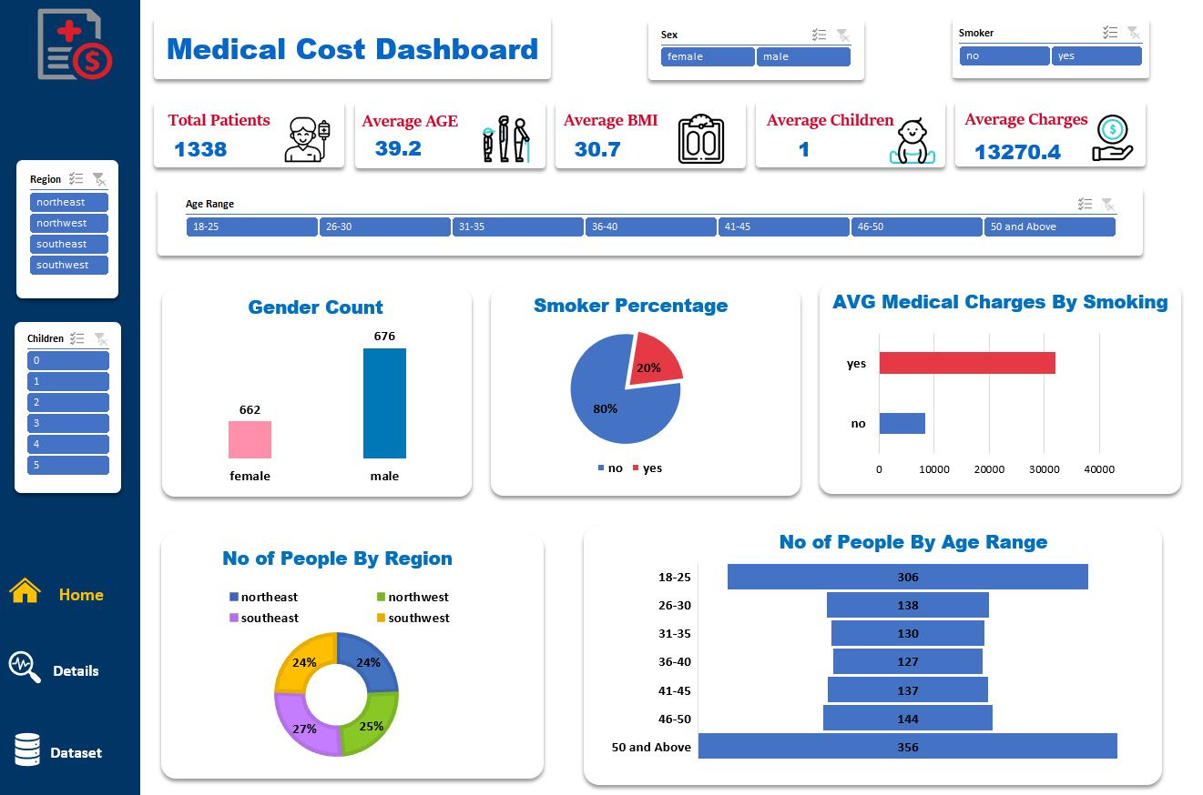
DASHBOARDS

Slide 6
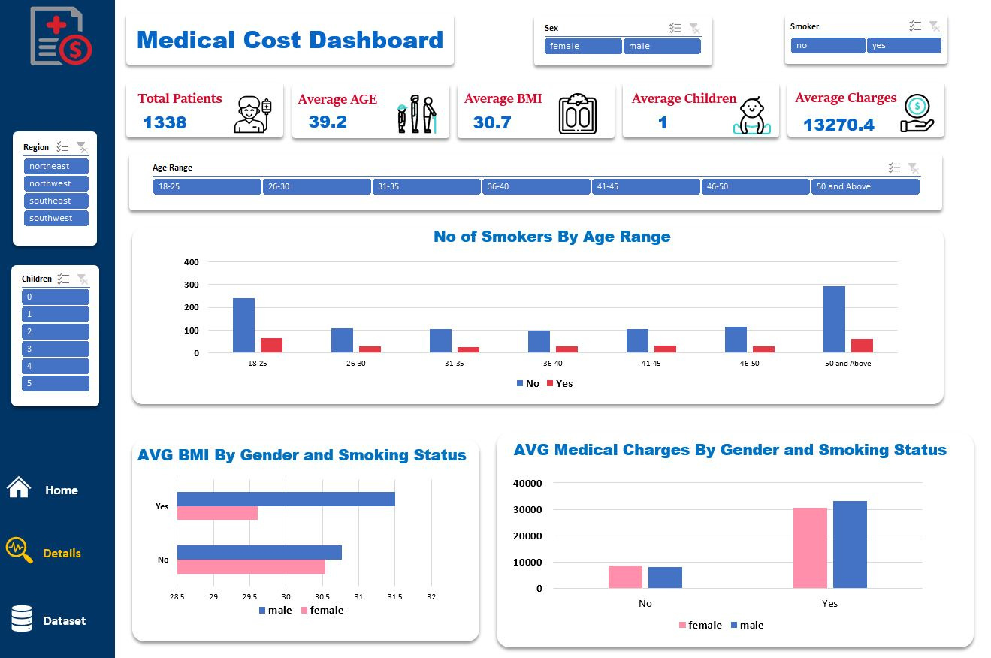
DASHBOARDS

Slide 7
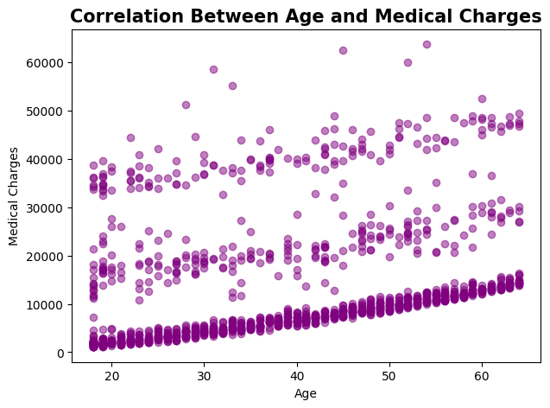
HYPOTHESIS TESTING
Performed Correlation Pearson Test
There is a Little Positive Correlation between Age and Medical Charges . If the Age will increase there is a chance the medical charges of a person will also increase

Slide 8
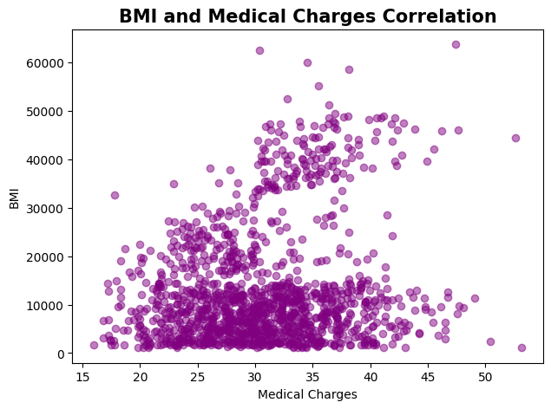

HYPOTHESIS TESTING
Performed Correlation Pearson Test
There A positive correlation between BMI and Medical Charges . We can observe the linear relationship between both. Whenever BMI will increase Medical Charges of Person will also increase

Slide 9
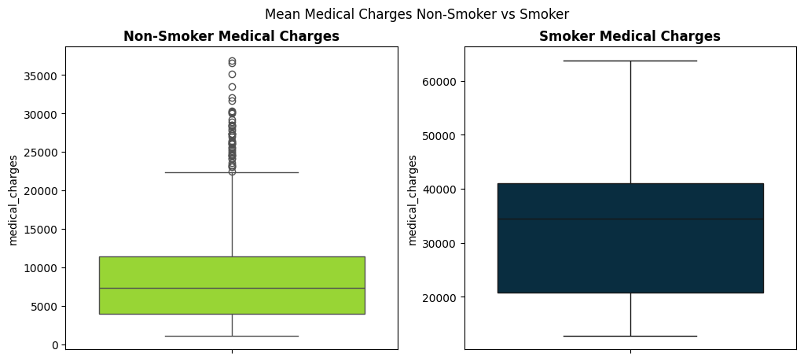
HYPOTHESIS TESTING
Performed T-Test to compare Mean of Smoker vs Non-Smoker Medical Charges
By Seeing the figures and by observing the test we can say that there is a significant difference between mean of medical charges or smoker and non-smoker

Slide 10
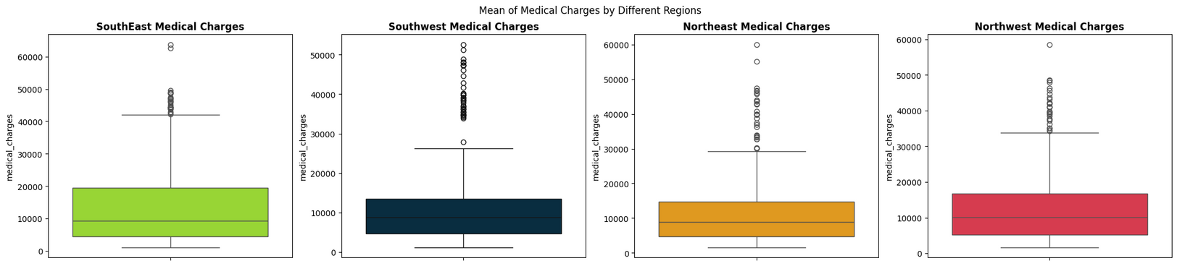

HYPOTHESIS TESTING
Performed One-way ANNOVA to compare Mean Medical Charges Across different regions
By Seeing the figures and by observing the test we can say that there is a significant difference between mean of medical charges of different Regions

Slide 11
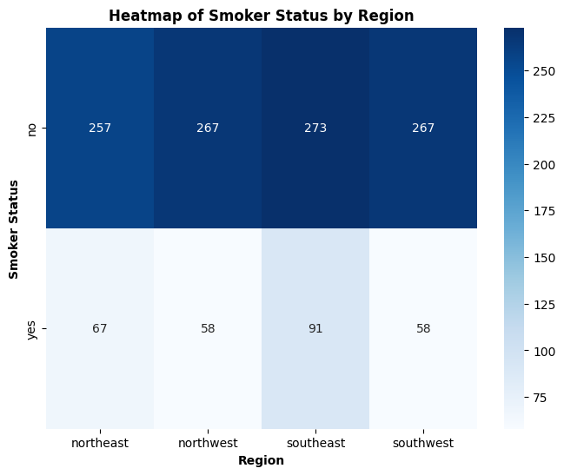

HYPOTHESIS TESTING
Performed Chi-Square Test to check association between smoker and region
By observing the test we can say that there is no significant Association between Smoker Status and Region

Slide 12

INSIGHTS
Males slightly outnumber females in the dataset, with 676 males and 662 females.
There are 20% Smokers and 80% Non-Smokers of the Whole population of the patients
There is a Significantly High Difference Between The Medical Charges of Patients who smoke and who don’t smoke
Northeast Patients are 24% Northwest Patients are 24% . Southeast Patients are 27% and Southwest Patients are 25% of the Whole Population
Most of The People are of Age Range 18-25 and 50 above

Slide 13
INSIGHTS
Most of the Smokers and Non-Smokers are of Age Range 18-25 and 50 above other are less numbers of smokers and non-smokers .
Male Smokers have higher BMI as Compared to Female Smokers and also Male Non-smokers have higher BMI as compared to Female Non-Smokers
Average Medical Charges of Both Males and Females are high If they are smokers as compared to Non-Smokers
Further Insights can be Derived by Using the Dashboard

Slide 14




THANK YOU
Amish Ilyas
ilyasamish@gmail.com

